Slide 1
Mr. Sarvang Shah Accolades Solutions Mobile: +91 9067408464 Email ID: sarvang@accolades-solutions.com . www.accolades-solutions.com
Accolades HRMS Website – Coming Soon…on Date: 1 Feb 2022

Slide 2
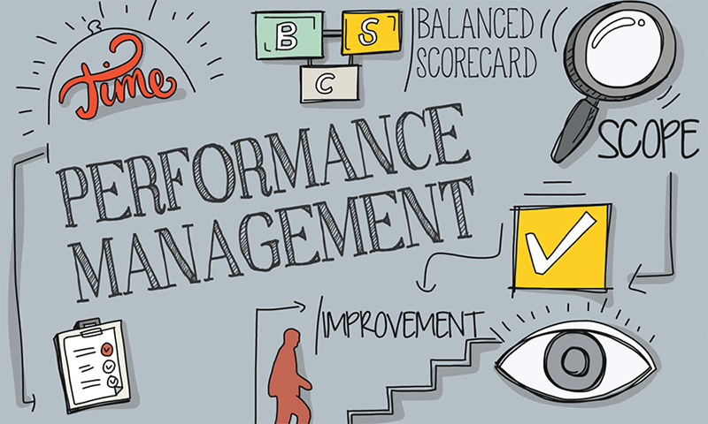
Accolades HRMS Website – Coming Soon…on Date: 1 Feb 2022

Slide 3
Accolades HRMS Website – Coming Soon…on Date: 1 Feb 2022

Slide 4
Introduction
Performance management is the current buzzword and is the need in the current times of cut throat competition and the organizational battle for leadership.
Performance management is a much broader function of HR, as it encompasses activities such as joint goal setting, continuous progress review and frequent communication, feedback and coaching for improved performance, implementation of employee development programmes and rewarding achievements.
The process of performance management starts with the joining of a new incumbent in a system and ends when an employee quits the organization

Slide 5
Objectives of performance management
To enable the employees towards achievement of superior standards of work performance.
To help the employees in identifying the knowledge and skills required for performing the job efficiently as this would drive their focus towards performing the right task in the right way.
Boosting the performance of the employees by encouraging employee empowerment, motivation and implementation of an effective reward mechanism.
Promoting a two way system of communication between the supervisors and the employees for clarifying expectations about the roles and accountabilities, communicating the functional and organizational goals, providing a regular and a transparent feedback for improving employee performance and continuous coaching.
Identifying the barriers to effective performance and resolving those barriers through constant monitoring, coaching and development interventions.
Creating a basis for several administrative decisions strategic planning, succession planning, promotions and performance based payment.

Slide 6
Benefits of performance management
Sr No | Benefits
Organization’s Benefits | Improved organizational performance, employee retention and loyalty, improved productivity, overcoming the barriers to communication, clear accountabilities, and cost advantages.
Manager’s Benefits | Saves time and reduces conflicts, ensures efficiency and consistency in performance.
Employee’s Benefits | Clarifies expectations of the employees, self assessment opportunities clarifies the job accountabilities and contributes to improved performance, clearly defines career paths and promotes job satisfaction.

Slide 7
Accolades HRMS Website – Coming Soon…

